Slide 1




NUS Databusters Group 34
Pitch Deck
Members
Celine Tan Yen Xiu
Damaen Tan Teck Hwe
Dawn Koh Wen Xi
Martha Henrietta Soetedjo
Link To Github Repository: tadamaen/NUS-DATABUSTERS-COMPETITION-GROUP-34
Notes:
Hello everyone, we are Group 34 from the NUS Databsters Challenge, and today we will be presenting the machine learning model and process we used to predict recessions. We'll walk you through the approach we took, including the data preparation, feature selection, model implementation, and the insights we gained from the analysis.

Slide 2



Which Dataset Did We Use?
Quarterly Data Monthly Data
Contains more relevant columns used for analysis (246 columns)
Reduces noise (smooths out random variations and provides a clearer trend)
Reducing overfitting & Model complexity
Much less relevant columns available (127 columns)
More noise due to higher probability of outliers
More prone to overfitting and complex models
Notes:
We are given two datasets, the quarterly data and the monthly data. We believe that the quarterly data is more beneficial for analysis and ML model implementation, as it includes more relevant features, minimizes noise, and reveals clearer trends by smoothing out random fluctuations. Additionally, using quarterly data helps decrease overfitting and model complexity, ultimately improving the accuracy of the model on test sets.

Slide 3



Data Cleaning Process
Step 1: Extracting Most Important Columns Of Dataset
Step 3: Finding And Handling NA Values
Step 5: Examining And Correcting Data Types
Step 2: Renaming Column Names To Readable Formats
Step 4: Checking For Any Duplicates
246 columns
Unreadable column names
NA values for certain columns
Incorrect data type for sasdate
32 columns
Readable column names
No more NA values
Correct data types
Initial Dataset:
Cleaned Dataset:
Notes:
For the data cleaning process, we took several steps, including selecting the most relevant columns, renaming them for better readability, handling missing values, checking for duplicates, and correcting any incorrect data types. After cleaning, the number of columns was reduced from 246 to 32, making the dataset more suitable for machine learning. Column names became more user-friendly, missing values were addressed, and the "sasdate" column was converted from an object type to a datetime type for accurate time series analysis.

Slide 4

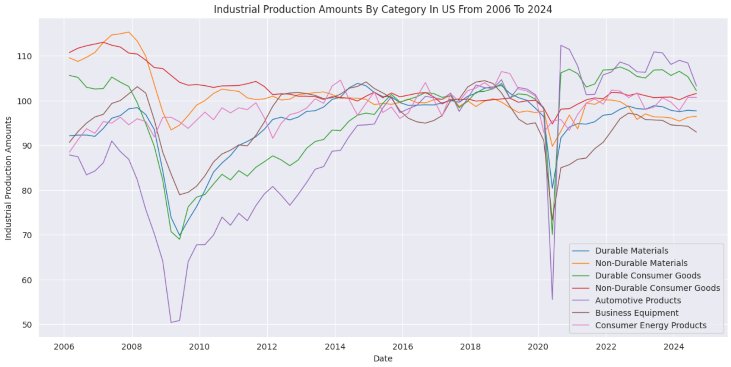
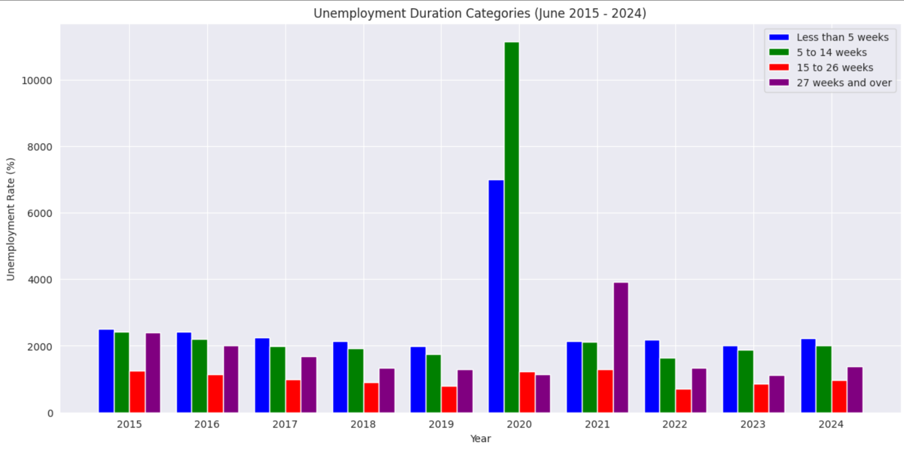
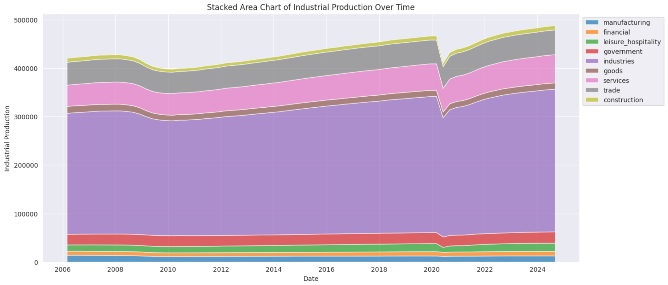
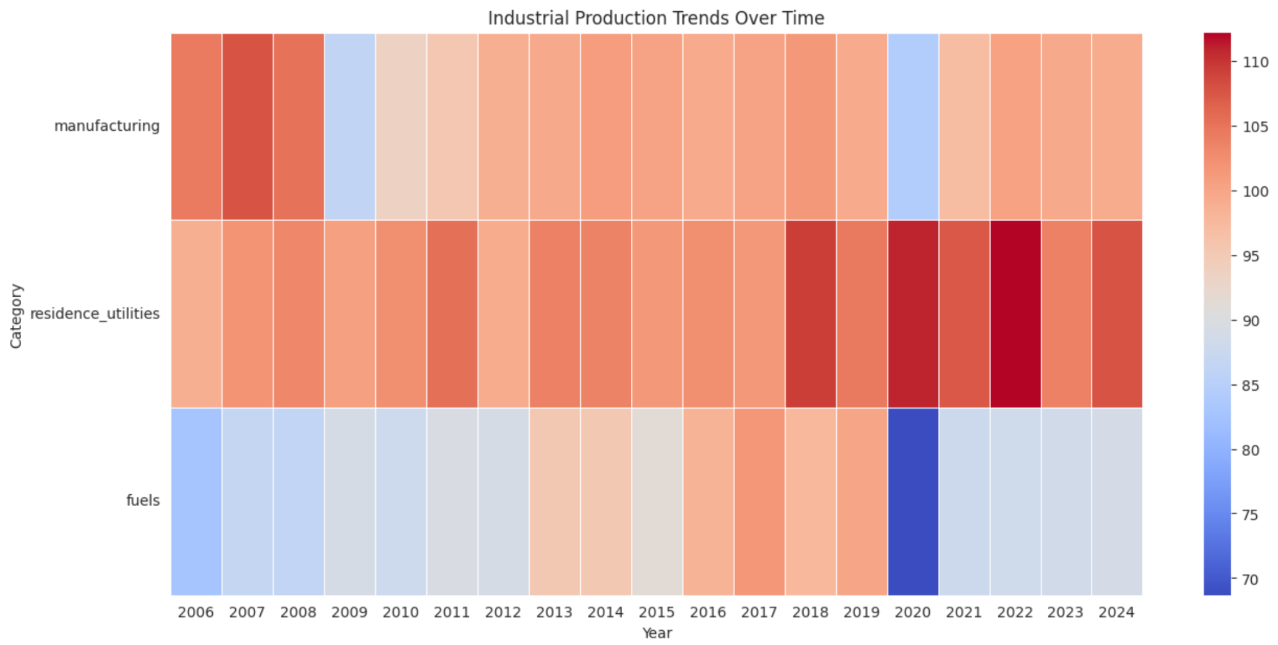
Data Visualizations
Performed 10 Different Visualizations:
Stock Prices Over Time
Imports And Exports Of Goods & Services
Real Disposable Personal Income
Industrial Production Amounts
Number Of Employees
Civilian Unemployment Rates
Personal Consumption Expenditures
Consumer Price Index
Industrial Production
Exchange Rates
Data Cleaning
Graph Plotting
Graph Types
Interesting Visualizations!
Line Plots (Trend)
Area Charts (Trend)
Bar Graphs (Year)
Heat Maps (Year)
Time-Series
Analysis
Analyze and suggest key findings from the visualizations afterwards
Notes:
Next, we conducted a series of data visualizations, exploring key metrics such as stock prices, imports and exports of goods and services, civilian unemployment rates, consumer price index, and exchange rates, among others. After refining the data and selecting the most appropriate types of plots, we created line plots and area charts for continuous time series analysis, along with bar graphs and heat maps for year-to-year comparisons. Finally, we analyzed the visualizations and provided insights into the key findings, explaining the trends and anomalies observed in the graphs.

Slide 5

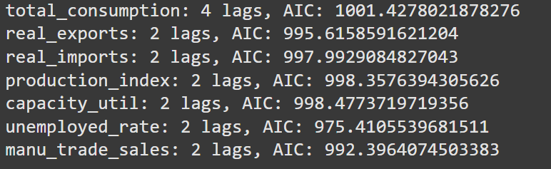
Machine Learning Model Implementation
Autoregressive Distributed Lag (ARDL) Model
Extends the Autoregressive (AR) model to predict economic downturns by capturing dynamic interactions with real GDP
Ensure stationarity in macroeconomic variables where differencing is applied before model fitting
Akaike Information Criterion (AIC) used to optimize model selection by choosing the best lag structure for improved forecasting accuracy
Notes:
To implement the Machine Learning model, we utilized the Autoregressive Distributed Lag (ARDL) model. This model builds upon the Autoregressive (AR) model to forecast economic downturns by capturing dynamic relationships with real GDP. It also ensures stationarity in macroeconomic variables through differencing before model fitting. Furthermore, we employed the Akaike Information Criterion (AIC) to optimize model selection by identifying the optimal lag structure for enhanced forecasting accuracy.

Slide 6


Machine Learning Model Evaluation
Durbin-Watson statistic (1.932): no significant autocorrelation
Omnibus (p = 0.000) and Jarque-Bera (p = 4.63e-47) tests: significant deviations from normality
Skew test (-1.804): extreme negative residuals
Kurtosis (11.714): a heavy-tailed distribution
Notes:
To accurately evaluate our model's performance, we must go beyond its predictive ability and assess the statistical properties of its residuals. Ensuring well-behaved residuals is crucial for a model’s validity, so we conducted a series of tests to check for autocorrelation, normality, skewness, and tailed-distribution. The Durbin-Watson statistic indicate no significant autocorrelation, which confirms that our residuals are independent. However, both the Omnibus and the Jarque-Bera tests, showed that the residuals significantly deviate from normality. We also observed extreme negative residuals, and a heavy-tailed distribution. In simple terms? Our data had outliers pulling the distribution in unexpected ways.

Slide 7

Machine Learning Model Evaluation
Removed outliers using Standardized Residuals, Cook’s distance, and Leverage
Durbin-Watson statistic (1.721) confirms no autocorrelation
Omnibus (p = 0.094) and Jarque-Bera (p = 0.151) tests: approximately normal
Skew test (-0.550): slight left skew
Kurtosis (3.506): mildly heavy tails
Notes:
To improve the reliability of our model, we identified and handled outliers in the residuals using standardized residuals, Cook’s distance, and leverage. After these adjustments, we reassessed the residual properties. Post-adjustment, the Omnibus and Jarque-Bera tests now suggested that our residuals were approximately normal. Plus, skewness improved and kurtosis dropped, meaning the extreme values are no longer a major concern. Our model’s residuals are now much better behaved, which strengthens its validity.

Slide 8
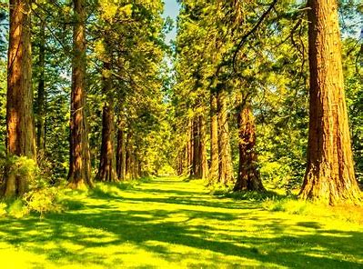
Machine Learning Model Optimization
Random Forest Regression for Economic Forecasting
Prepping our Dataset
Converting `real_gdp` column to show Quarter-on-Quarter GDP growth (denoted as `gdp_qq`)
Inclusion of financial market variables due to leading nature
Splitting of dataset into train and test sets
Ensuring that none of the variables are highly correlated to `gdp_qq`
Prevents duplicative results

Slide 9

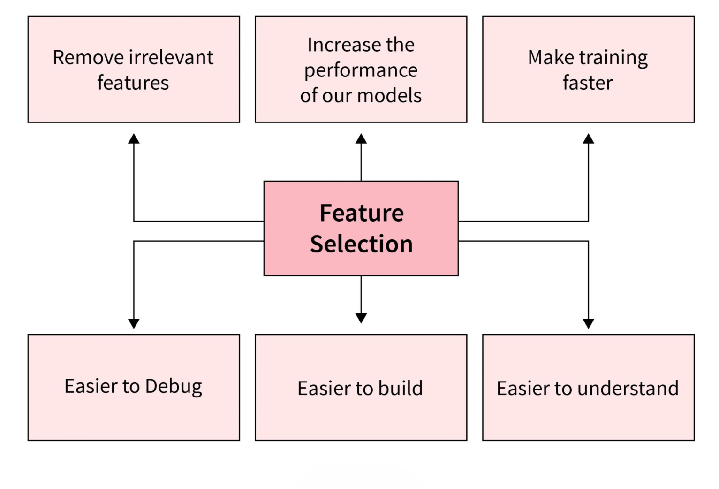
Feature Selection
Variable | Importance
consumer_sentiment | 0.286292
baa_corporate_bond_yield | 0.190009
average_weekly_hours | 0.136516
treasury_maturity | 0.076998
policy_uncertainty | 0.073427
new_priv_housing_unit_perms | 0.065799
inventory_sales_ratio | 0.059206
unemployed_rate | 0.033431
real_exports | 0.021775
sp500_price | 0.015363
real_imports | 0.014191
production_index | 0.013969
cpi | 0.013024
Feature selection using importances, defined as the contribution of variable to RF model
Top 9 variables were selected for refitting with train and test data

Slide 10
RF Model Evaluation
Using Mean Absolute Percentage Error (MAPE), R², Root Mean Squared Error (RMSE) and Mean Absolute Error (MAE) as evaluation metrics
Due to drastic and anomalous change during COVID-19, a separate test set was created up to Q4 2019 for evaluation
Evaluation Metric | Train data | Test Data | Test Data (up to Q4 2019)
MAPE | 63.969% | 95.583% | 63.391%
R² | 0.772 | -0.038 | -0.717
RMSE | 0.2882 | 1.7385 | 0.4599
MAE | 0.2354 | 0.8459 | 0.3831

Slide 11
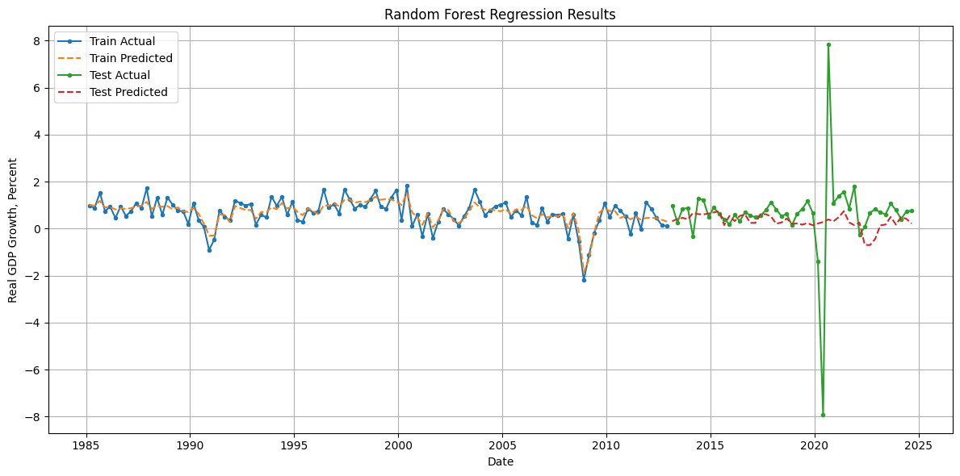
Random Forest for Economic Forecasting

Slide 12
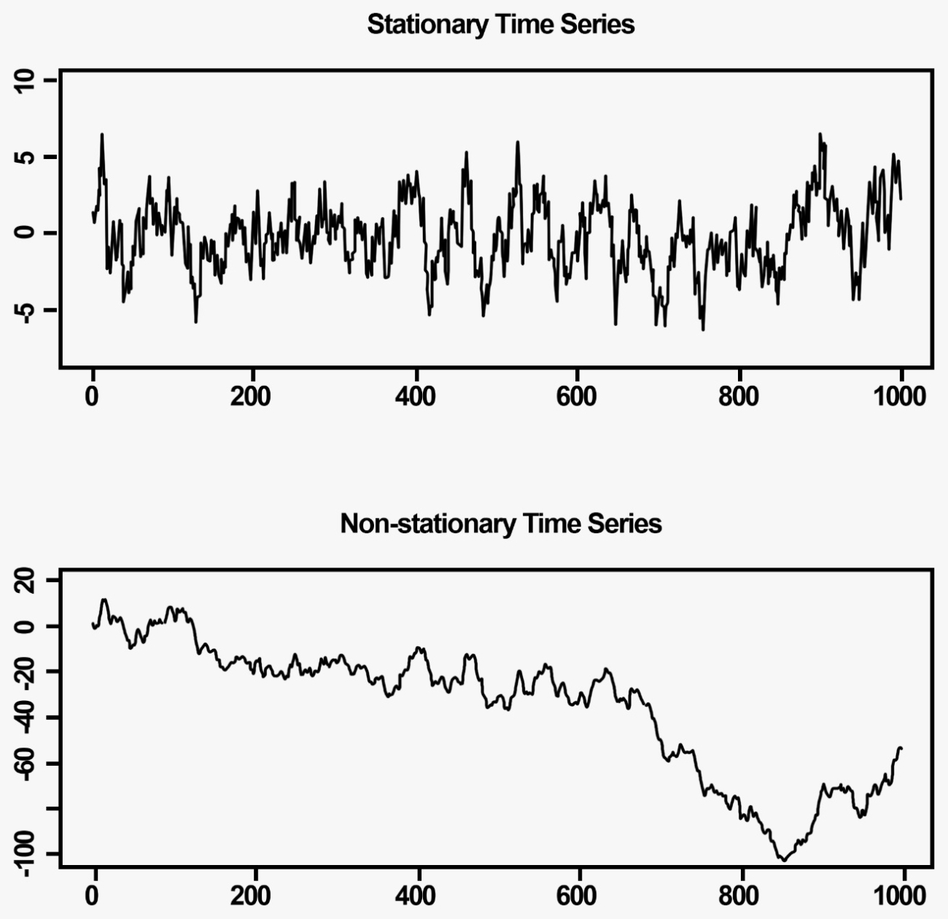
Creating Forecast data with RF and ARIMA
ARIMA Model for forecasting future variable values
RF model is unable to forecast on its own without input of future exogenous variables
Autoregressive Integrated Moving Average (ARIMA) is utilised to generate next 5 quarters of data
Checked for stationarity, differencing employed for non-stationary data
Selection for best order of autoregressive (p) and moving average components (q)

Slide 13

Forecasting Future Quarterly GDP Growth
Forecasting with future exogenous values
With forecasted values, our model can then predict GDP growth for next 5 quarters
Generally consistent trend of approx. -0.55 growth
Not just economic contraction, but economic recession!
Date | GDP Growth Forecast
2024-12-01 | -0.552358
2025-03-01 | -0.552358
2025-06-01 | -0.552358
2025-09-01 | -0.543941
2025-12-01 | -0.543941
Given that consumer sentiments were some of the greatest contributors to the model,
there may be some expectations of a worsening economy, hence suggesting future slowing in productivity, leading to a fall in GDP

Slide 14

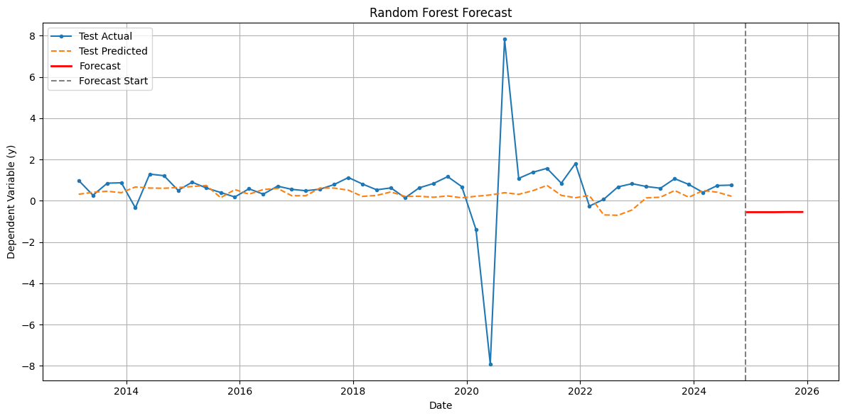
Forecasting Future Quarterly GDP Growth

Slide 15

Possible Improvements That Can Be Made To Model
1. ARDL Model
Addressing Non-Linearity:
ARDL assumes a linear relationship between variables, which may not capture complex macroeconomic effects.
Consider Threshold ARDL (TARDL) or Nonlinear ARDL (NARDL) to model asymmetric relationships.
2. Random Forest Model
Optimizing accuracy
Using ensemble methods such as bagging and boosting (XGBoost or AdaBoost)

Slide 16


